Slide 1
Introduction to Kubernetes for Developers
Orlando Code Camp
Jason L. van Brackel
25 March 2023

Slide 2
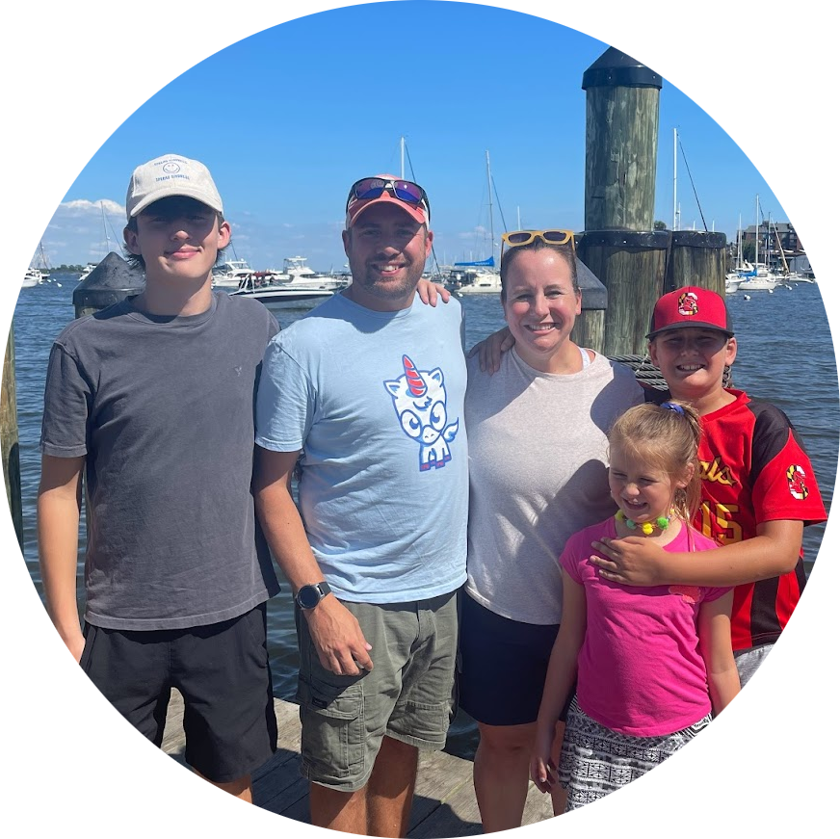





CONTACT ME
Jason van Brackel
Unicorn Engineer
@JvB
@jasonvanbrackel
jasonvanbrackel
#Zarf at https://slack.kubernetes.io
@defenseunicorns
Defense Unicorns

Slide 3
Agenda
Kubernetes
Concepts
Tools
Where can I get Started?
Kitchen Sink
What Else?
Q&A
Your Turn!

Slide 4
Introduction to Gather
Quick Notes
Move with arrows or mouse click
’x’ to interact with objects
‘g’ to ghost through people
‘f’ to throw some confetti
’z’ dance party!

Slide 5
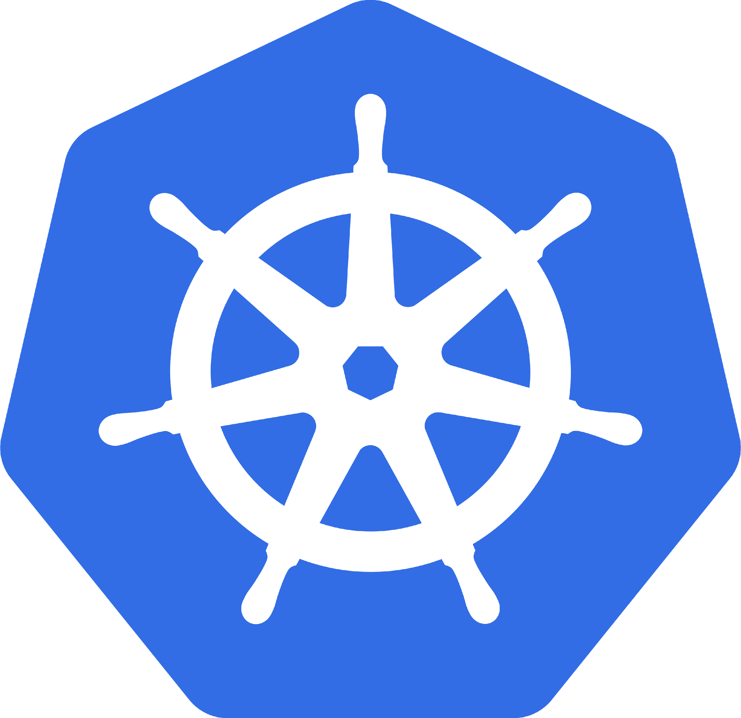
What is Kubernetes
Orchestrates Containers
That’s it? That’s all it does!

Slide 6
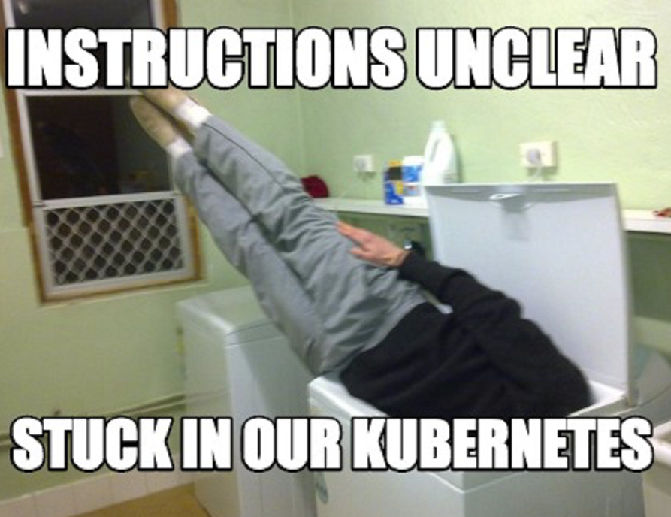
It Is Complex
Scale
Kubernetes Reference API
What is Kubernetes Physically Speaking?

Slide 7
Why Should I care?
Developers
Operators
It’s Everwhere

Slide 8

Why Should Developers care?
Containerized Applications
Breaking the Monolith
It’s the Substrate

Slide 9
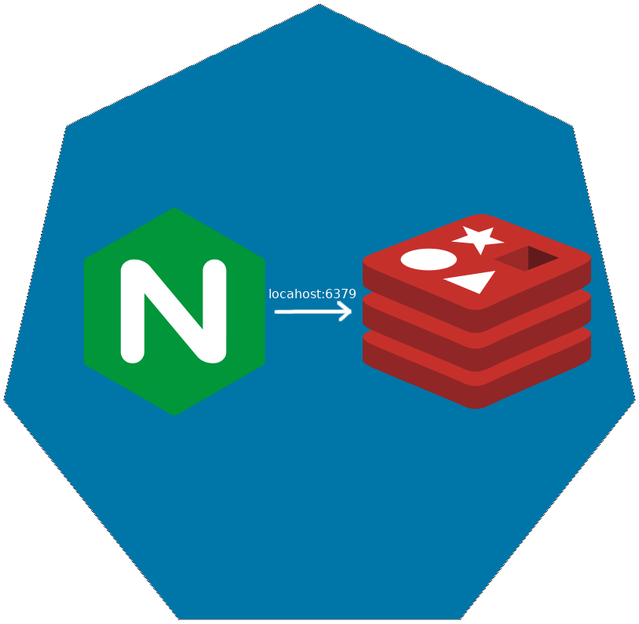
Pod
Co-scheduled
Shared Network Namespace
Shared Files System

Slide 10

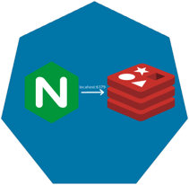
ReplicaSet

Slide 11

ReplicaSet

Slide 12
ReplicaSet

Slide 13
Deployments

Slide 14
Deployments

Slide 15
Deployments

Slide 16
Deployments

Slide 17
Deployments

Slide 18
Services
Define a DNS entry that can be used to refer to a group of pods
Provide a consistent endpoint for the group of pods
Different types: nodePort, clusterIP, loadbalancer
#rancherk8s

Slide 19


Services (Node Port)
192.168.0.[1-3]:32000

Slide 20
Services (Load Balancer)
Public IP:80

Slide 21
Config Maps & Secrets
Allow storing of arbitrary configuration values and files
Exposed in pods as either environment variables or as local storage
Decoupled storage of configuration from pod spec
#rancherk8s

Slide 22
Config Maps & Secrets
apiVersion: v1
kind: ConfigMap
metadata:
name: dev-config
namespace: default
data:
Item1: dev-stuff
Item2: more dev stuff
apiVersion: v1
kind: ConfigMap
metadata:
name: qa-config
namespace: default
data:
Item1: qa-stuff
Item2: more qa stuff
apiVersion: v1
kind: ConfigMap
metadata:
name: prod-config
namespace: default
data:
Item1: prod-stuff
Item2: more prod stuff

Slide 23
Ingresses
Define how traffic outside the cluster is routed to inside the cluster
Used to expose Kubernetes services to the world
Route traffic to internal services based on factors such as host and path
Ingress is usually implemented by a load balancer (Nginx, HAProxy, AWS ELB, etc…)
#rancherk8s

Slide 24

Ingresses
Ingress Controller
https://my-nginx-app.cluster.com https://cluster.com/my-nginx-app

Slide 25
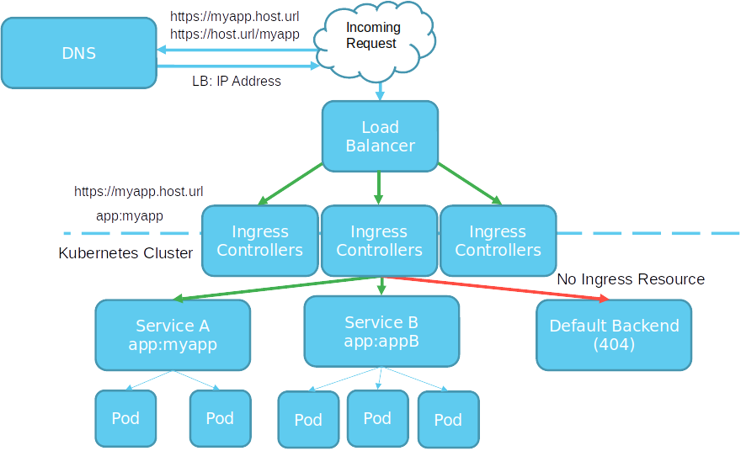

Slide 26
Tools
Running Kubernetes Locally
Running Kubernetes In The Cloud
Dealing with Scale

Slide 27
Running Kubernetes Locally
K3s
K3d
Rancher
Docker
Kind
KWOK

Slide 28
Running Kubernetes In the Cloud
AKS
EKS
GKE
Digital Ocean
Linode

Slide 29
Dealing with Scale
Find a framework you like
ELK
PLG
Don’t Over Alert

Slide 30
Packaging and Supply Chain Security
Chainguard
Zarf

Slide 31
The Kitchen Sink
https://landscape.cncf.io/

Slide 32
ANY QUESTIONS?

Slide 33
Get In Touch
#Zarf at https://slack.kubernetes.io
@defenseunicorns
Defense Unicorns
@JvB
@jasonvanbrackel
jasonvanbrackel

